Slide 1
CONDITIONAL STATEMENTS AND LOOPS

Slide 2
Review: What is a Boolean?

Slide 3
Workflow Diagrams

Slide 4
CONDITIONAL STATEMENTS
Conditions are expressions that evaluate to a Boolean value
They often involve comparison operators (<, >, ==, !=, <=, >=) and logical operators (and, or, not)
Python relies on indentation (whitespace at the beginning of a line) to define code blocks
Incorrect indentation will lead to errors.
You can create Nested Conditional Statements to control the flow of code

Slide 5
THE "IF" STATEMENT
Executes a block of code only if a given condition evaluates to True
Syntax:
  if condition:
  # code
Example:
  age = 20
  if age >= 18:
  print(“You are eligible to vote.”)

Slide 6
THE “ELSE” STATEMENT
“Else” is used in conjunction with “if”
Provides an alternate block of code to execute if the “if” condition evaluates to false
Syntax:
  if condition:
  # code
  else condition:
  # code
Example:
  temperature = 78
  if temperature > 85:
  print(“It’s hot out today!”)
  else:
  print(“It’s not too hot.”)

Slide 7
THE “ELIF” STATEMENT
“elif” is short for else-if
It allows for checking multiple conditions sequentially
If the “if” condition evaluates to false, the “elif” statements are evaluated in order until one evaluates to True
Syntax:
  if condition:
  # code
  elif condition:
  # code
  else condition:
  # code
Example:
  score = 89
  if score >= 90:
  print(“Grade: A”)
  elif score >= 80:
  print(“Grade: B”)
  elif score >= 70:
  print(“Grade: C”)
  elif score >= 60:
  print(“Grade: D”)
  else:
  print(“Grade: F”)

Slide 8
NESTED CONDITIONAL STATEMENTS
You can place “if” or “if...else” statements inside other “if” or “else” blocks to create more complex decision structures.
Example:
  weather = "rainy“
  temperature = 45
  if weather == "rainy":
  if temperature < 50:
  print("It's cold and rainy. Wear a jacket and bring an umbrella.")
  else:
  print("It's rainy but warm. Just bring an umbrella.")
  else:
  print("No rain today. Enjoy the weather!")
Code Examples

Slide 9
EXERCISE - CONDITIONAL STATEMENTS
5 minutes
Write a function that checks a number and returns “positive,” “zero,” or “negative”
Notes:
Remember:
Defining a function
If-elif-else
Comparison operators
Early exits

Slide 10
Loops!

Slide 11
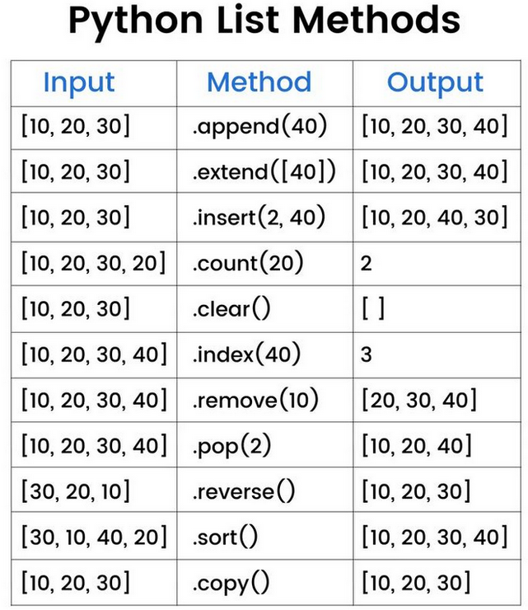
But first, a new datatype!
The humble list
Example:
  my_list = ['hello']
  my_list.append('goodbye')
  my_list.append(5)
  my_list.append(True)
  my_list
  ['hello', 'goodbye', 5, True]
  len(my_list)
  4

Slide 12
LOOPS
Fundamental control flow structures used to execute a block of code repeatedly
Two primary types of loops are “for” and “while” loops, which have distinct purposes
You can nest loops

Slide 13
RANGE() FUNCTION
A built-in Python function
Output is a “range object,” which is an immutable sequence type and memory efficient compared to a list
range(stop)
  Generates a sequence of numbers starting from 0 (default) up to, but not including, the stop value
  The numbers increment by 1 (default)
  Example: range(5) generates 0, 1, 2, 3, 4
range(start, stop)
  Generates a sequence of numbers starting from the start value (inclusive) up to, but not including, the stop value
  The numbers increment by 1 (default)
  Example: range(2, 7) generates 2, 3, 4, 5, 6
range(start, stop, step)
  Generates a sequence of numbers starting from the start value (inclusive) up to, but not including, the stop value
  The numbers increment or decrement by the step value (integer!)
  If step is positive, it increments. If step is negative, it decrements (for counting backwards).
  step cannot be 0, as it would lead to an infinite loop and raise a ValueError
  Example: range(1, 10, 2) generates 1, 3, 5, 7, 9
  Example: range(5, 0, -1) generates 5, 4, 3, 2, 1

Slide 14
“FOR” LOOP
For loops iterate over a sequence, such as a list, tuple, string, or range, or other iterable objects
A block of code is executed once for each item in the sequence
Syntax:
  for variable in sequence:
  # code
Example:
  fruits = ["apple", "banana", "cherry"]
  for fruit in fruits:
  print(fruit)

Slide 15
“WHILE” LOOP
While loops execute a block of statements repeatedly as long as a given condition is True
The loop continues to execute until the condition becomes false
Forever loops
Syntax:
  while condition:
  # block of code
Example:
  count = 0
  while count < 5:
  print(count)
  count += 1

Slide 16
Hands-On #1

Slide 17
More Loops

Slide 18
LOOP CONTROL STATEMENTS
break
  terminates the current loop immediately, execution resumes at the statement following the loop
continue
  skips the rest of the current iteration of the loop and proceeds to the next iteration
pass
  null operation, used as a placeholder in loops or other code blocks where a statement is syntactically required but there is nothing to execute

Slide 19
NESTED LOOPS
Python allows loops inside other loops, called nested loops
The inner loop executes completely for each iteration of the outer loop
Example:
  for i in range(3):
  for j in range(2):
  print(i, j)

Slide 20
Hands-On #2

Slide 21
PYTHON ERRORS
Errors are issues in a program that prevent it from running as expected
They help programmers find and fix mistakes
Why learn errors?
  Errors help you debug
  Knowing common errors makes writing and fixing code faster
  Good programs handle errors gracefully

Slide 22
EXERCISE - PYTHON ERRORS
5 minutes
Groups of 2-3
Research each python error and demonstrate an example case of when this error will be raised
SyntaxError
IndentationError
TypeError
ValueError
ZeroDivisionError
IndexError
KeyError
AttributeError
FileNotFoundError
ImportError

Slide 23
Type | When it Happens | Example
SyntaxError | Code violates Python’s rules | Missing colon :
IndentationError | Code has wrong indentation | Misaligned blocks
TypeError | Wrong type used in operation | Add int to str
ValueError | Right type, wrong value | int("abc")
ZeroDivisionError | Dividing by zero | 5 / 0
IndexError | Index out of range in a sequence | list[5] with 3 items
KeyError | Missing key in a dictionary | dict["missing"]
AttributeError | Attribute doesn’t exist | int.append()
FileNotFoundError | File does not exist | Open missing file
ImportError | Cannot import a module | Wrong module name

Slide 24
ERROR HANDLING
Why Handle Errors?
  Prevent your program from crashing
  Provide helpful messages to users
  Let your code recover from unexpected situations

Slide 25
TRY - EXCEPT
Tries a block a code and if an error is raised, can handle that error neatly
Example:
try:
# code that might cause an error
number = int("abc")
except ValueError:
print("Oops! That wasn't a number.")

Slide 26
TRY - EXCEPT CONTINUED
Optional
  else: Runs if no error occurs
  finally: always runs
Example
try:
result = 10 / 2
except ZeroDivisionError:
print("Cannot divide by zero.")
else:
print("Division successful.")
finally:
print("Done.")

Slide 27
RAISE
“raise” is used to intentionally trigger an error
Helps enforce rules and catch problems early
Make your code more predictable and safe
Useful for custom error messages or defining your own exceptions
Syntax
if age < 0:
raise ValueError("Age cannot be negative.")
Built-in Exceptions
raise TypeError("This function only accepts strings.")
raise ZeroDivisionError("Cannot divide by zero.")
Raised errors can be caught and handled with try / except
If not caught, they will be passed to the output and stop the program

Slide 28
FINAL CODING EXERCISE
20 min
Write a block of code that takes in user input until they guess the random number
Prompt the user to help them with their guess
Handle the following situations
User does not input the right python data type
User inputs a negative number
User inputs a number outside the guess range
Hint: use random.randomint() to generate a random number

Slide 29
FINAL CODING EXERCISE
20 min
Given a list of numbers, write a program that:
Loops through the list
Skips any None values or non-integer types with an error message using try/except
Raises a ValueError if it finds a negative number (stops the program)
Collects all valid positive integers into a new list
Prints the new list and the sum of its numbers
List: [10, -5, 20, ‘hello’, 5.2, 15, None, 30]
Once you have a solution, remove -5 from the list and run it again.
Hints:
Use isinstance(item, int) to check types
Build the valid list as you go

